Slide 1

ALGORITHMIC TRADING
CMR COLLEGE OF ENGINEERING & TECHNOLOGY
Kandlakoya, Medchal, Hyderabad - 501401
Department of Computer Science and Engineering
BATCH NO. 62
L Bharadwaj 18H51A0517
M M Prathyush 18H51A0518
G Vineetkumar 18H51A0596
Under esteemed guidance of
Dr. Sarat Chandra Nayak

Slide 2

CMR COLLEGE OF ENGINEERING & TECHNOLOGY
Kandlakoya, Medchal, Hyderabad - 501401
Department of Computer Science and Engineering
ALGORITHMIC TRADING
BATCH NO. 62
L Bharadwaj 18H51A0517
M M Prathyush 18H51A0518
G Vineetkumar 18H51A0596
Under esteemed guidance of
Dr. Sarat Chandra Nayak

Slide 3
ABSTRACT
Stock market is just like a probabilistic trading where we can gain and have possibility of loss. Investing in stock market trading might be a risky task. So, we can use algorithmic trading which uses the previous trends of a particular stock and help us predicting investing in the stock. Algorithmic trading using machine learning techniques to increase the probability of profit because it uses the technical analysis of stock, price action strategies, seasonal trends and help us to predict which time is better to invest in stocks. So, we will not fall in debts anymore. We are developing an algorithm using machine learning and deep learning techniques like CNN(Convolutional Neural Network) and RNN(Recurrent Neural Network) for predictions.

Slide 4
PROBLEM UNDERSTANDING
MOTIVATION OF STUDY
OBJECTIVES
PROBLEM STATEMENT, SCOPE & LIMITATIONS

Slide 5
MOTIVATION OF STUDY
Now a day’s, the prediction of stock market prices has become a major research topic
The behavior of stock market is very nonlinear and volatile in nature.
So Investing has become a risky task for the people.
But it is not at all a risky task to machine that uses machine learning techniques.
Infact the predictions will be very close to real time data

Slide 6

OBJECTIVE
To design efficient system for predicting the stock market movement using ML .
Specifically, use LSTM method to Predict stock price based on the historical data.
Compare existing methods to show the superiority of LSTM.

Slide 7

PROBLEM STATEMENT
Stock market is just like a probabilistic trading where we can gain and have possibility of loss. Investing in stock market trading might be a risky task. So, we can use algorithmic trading which uses the previous trends of a particular stock and help us predicting investing in the stock that gives us more profit.
P/E * EPS = PRICE
If we can predict stocks future P/E and EPS, We will know accurate PRICE

Slide 8

SCOPE & LIMITATIONS
We predict the stock market upto one month.
It is hard to predict in the pandemic sitations

Slide 9
LITERATURE SURVEY

Slide 10

Statistical
Auto-Regressive Integrated Moving Average
(ARIMA)
ARIMA models are known to be robust and efficient in financial time series forecasting
It constantly outperformed complex structural models in short-term prediction
But they work only for a particular time series data
It is categorized into linear that is it cannot handle nonlinear behavior of stock market

Slide 11

Machine Learning
Logistic Regression
Decision tree
Random Forest
ANN (Artificial Neural Network)
Naive bayes

Slide 12

Deep Learning
RNN (Recurrent Neural Network)
GRU (Gated Recurrent Units)
LSTM (Long Short Term Memory )

Slide 13

RNN (Recurrent Neural Network)
RNN is a class of advanced artificial neural network (ANN)
It is categorized into nonlinear
RNN takes input from two sources, one is from the present and the other from the past
Information from these two sources are used to decide how they react to the new set of data
But fails in forecasting long term duration

Slide 14

LSTM Long-Short-Term Memory
LSTM is an advanced type of RNN
LSTM is proficient in learning about long-term dependencies.
LSTM is popularly used on time-series data for classification, processing, and making predictions.

Slide 15

Gated Recurrent Units (GRUs)
GRU is one of the variants of RNN
it solves the problem that RNN is difficult to deal with long-distance information
Compared with LSTM, GRU is simplified

Slide 16
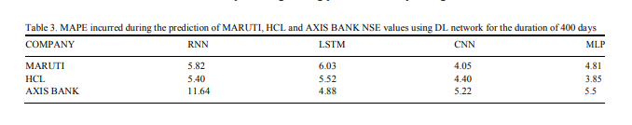
comparison

Slide 17
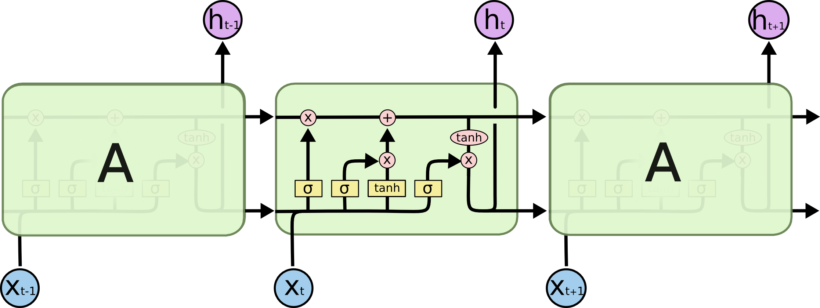
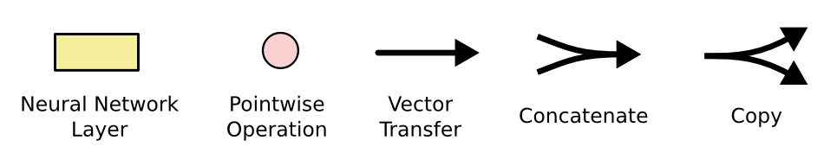
STRUCTURE OF LSTM

Slide 18
STRUCTURE OF LSTM
Long Short Term Memory Network is an advanced RNN, a sequential network, that allows information to persist. It is capable of handling the vanishing gradient problem faced by RNN. A recurrent neural network is also known as RNN is used for persistent memory.
The first part chooses whether the information coming from the previous timestamp is to be remembered or is irrelevant and can be forgotten. In the second part, the cell tries to learn new information from the input to this cell. At last, in the third part, the cell passes the updated information from the current timestamp to the next timestamp. These three parts of an LSTM cell are known as gates. The first part is called Forget gate, the second part is known as the Input gate and the last one is the Output gate.

Slide 19
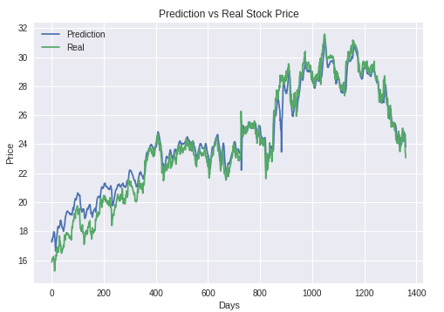
LSTM
Predicting Stock Price with LSTM
We choosen it because its prediction is very close to real values.
It is widely used for sequence prediction and have proven to be extremely effective.
LSTM can store past important information and forget the useless information.
FIG: LSTM SAMPLE RESULT

Slide 20
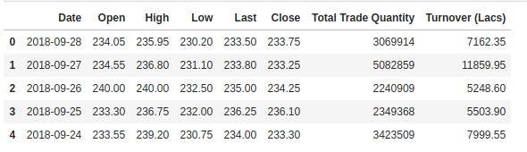
DATA SET COLLECTION
NSE (National Stock Exchange of India)
BSE (Bombay Stock Exchange)
NYSE (New York Stock Exchange)
Money Control
Google Stock Prices
Yahoo
China’s Shanghai and Shenzhen stock markets
Fig: Sample data set

Slide 21
PROCESS
Loading the Data
Train and Test Split
LSTM
Prediction
Results
Conclusion

Slide 22

REFERENCES
IEEE RESEARCH
https://sci-hub.ee/10.1109/aiam48774.2019.00113

Slide 23
THANK YOU
ALL
OUR GUIDE
TEAM

